Slide 1

Green Skilling, Sustainability & AI (SDG 17)
Student Details
• Name: Patel Rutu
• Enrollment No.: 230760116097
• Stream: Information Technology (IT)
• College: SSASIT, Surat.
• Presentation covers sustainable data centres, ecological footprint, carbon calculators, En-ROADS climate simulation, NANDO AI Smart Bins, SCGJ Green Jobs, AI for sustainability, and AI-based capstone project ideas.
Add Screenshots Here

Slide 2
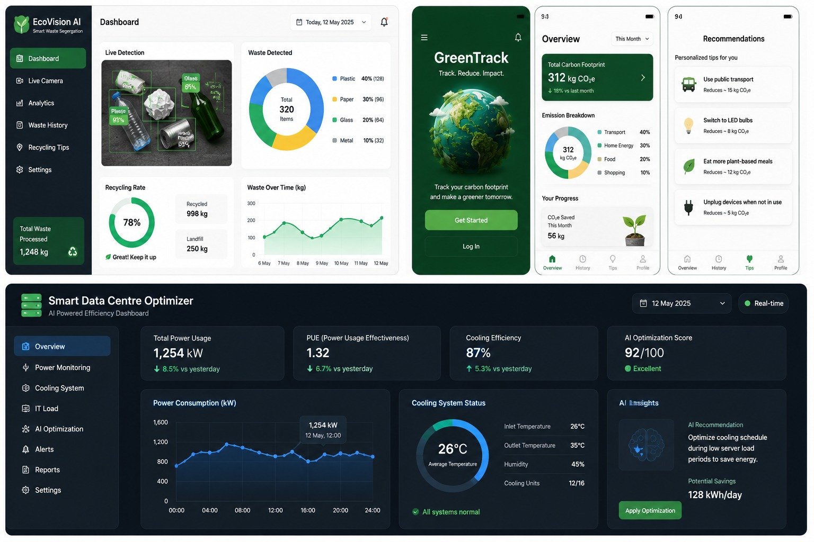
What I Learned from the Given Resources
Key Learnings
• The Data Centre documentary explained that modern AI, cloud computing and online services depend on large data centres that consume huge amounts of electricity and water for cooling.
• Ecological Footprint Calculator helped me understand how food, transport and energy use affect Earth's natural resources.
• Carbon Calculators (Conservation International and e-AMRIT) showed how everyday activities produce CO₂ emissions and suggested ways to reduce them.
• EcoTransIT estimates emissions from road, rail, air and sea transport, helping businesses choose greener logistics.
Add Screenshots Here

Slide 3
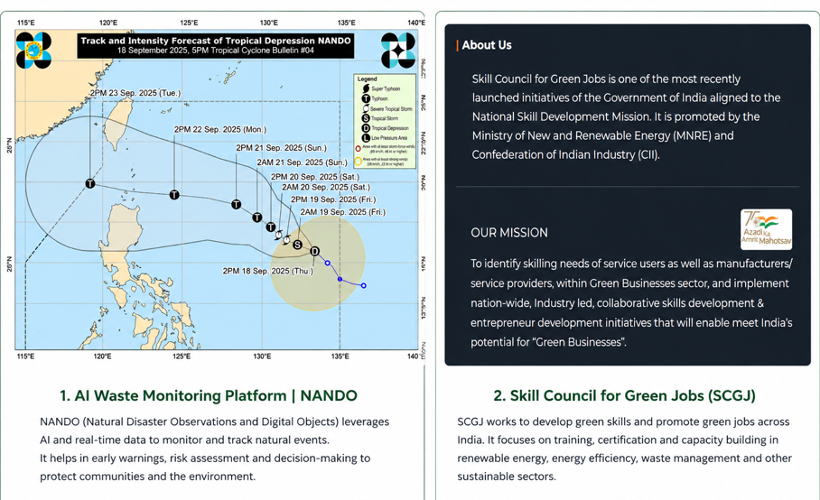
Green Skilling, AI & Sustainability
Important Concepts
• Green Skilling means learning skills that help protect the environment through renewable energy, recycling and sustainable industries.
• Sustainability focuses on meeting today's needs while protecting resources for future generations.
• NANDO AI Smart Bins use artificial intelligence to recognize waste and improve recycling efficiency.
• SCGJ (Skill Council for Green Jobs) provides training for careers in solar energy, electric vehicles and other green sectors.
• AI supports pollution monitoring, climate prediction and energy optimization, but AI infrastructure also consumes electricity and creates e-waste.
Add Screenshots Here

Slide 4
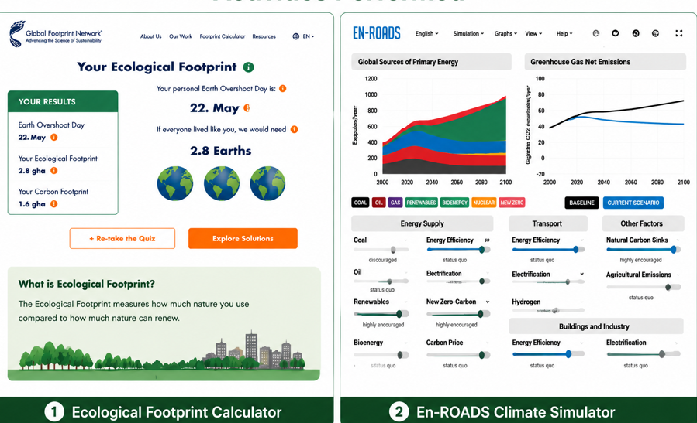
Activities Performed
Websites & Tools Explored
• Completed the Ecological Footprint Calculator.
• Explored Conservation International Carbon Calculator.
• Estimated transport emissions using EcoTransIT.
• Experimented with different scenarios in the En-ROADS Climate Simulator.
• Visited NANDO AI Smart Bins, Gen.E Media and SCGJ websites.
• Used the e-AMRIT CO₂ Calculator to compare vehicle emissions.
Add Screenshots Here

Slide 5
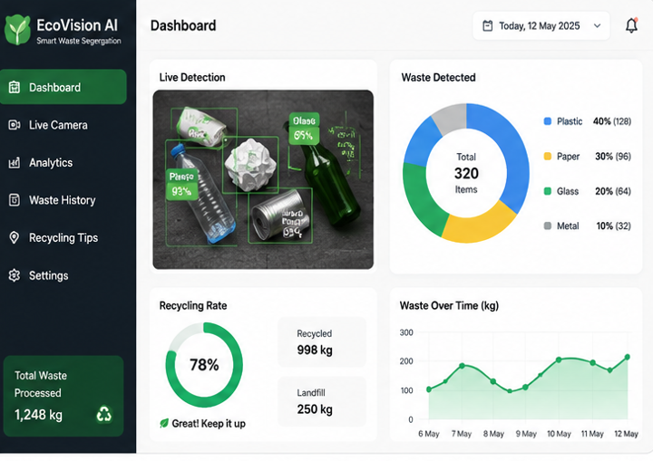
Capstone Project Ideas
AI for Environment & SDG 17
• EcoVision AI – Smart waste segregation using image recognition.
• GreenTrack – AI-powered carbon footprint tracker with personalized suggestions.
• EcoRoute AI – Suggests low-emission travel routes.
• Green Skill Connect – Recommends green courses, certifications and jobs.
• Smart Data Centre Optimizer – Uses AI to reduce power and cooling consumption.

Slide 6
print("="*50)
print("AI-Based Sustainable Partnership Recommendation")
print("SDG 17: Partnerships for the Goals")
print("="*50)
project = input("\nEnter your sustainability project topic: ")
results = recommend_partners(project)
print("\nRecommended Partners:\n")
for partner, score in results:
if score > 0:
print(f"{partner} --> Match Score: {score}")
if max([score for _, score in results]) == 0:
print("No exact match found.")
print("Suggested: University Research Center")
# AI-Based Sustainable Partnership Recommendation System
# SDG 17: Partnerships for the Goals
# Database of organizations and their focus areas
partners = {
"Government Environmental Agency": [
"climate", "pollution", "forest", "water", "environment"
],
"Renewable Energy Company": [
"solar", "wind", "energy", "electricity", "renewable"
],
"NGO for Sustainability": [
"waste", "recycling", "community", "sustainability"
],
"Agricultural Research Institute": [
"farming", "agriculture", "soil", "crop", "water"
],
"University Research Center": [
"research", "technology", "ai", "innovation"
]
}

